Slide 1
Significant tests for network characteristics of genes that display acetylation and phosphorylation

Slide 2
Methods
Set alpha .05
Loop through centralities in each dataset
Apply t and Kolmogorov–Smirnov test
Check for significant difference between centrality distributions between each positive and negative correlations

Slide 3
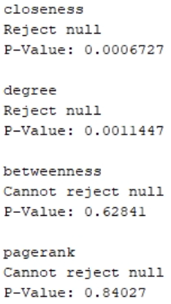
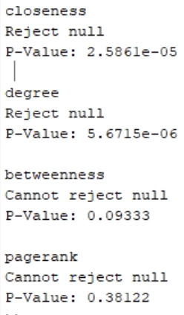
Results
t test
Kolmogorov–Smirnov
test

Slide 4
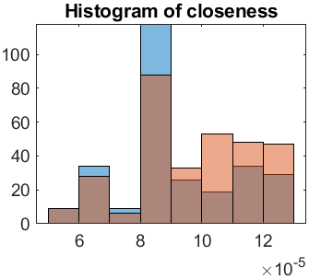
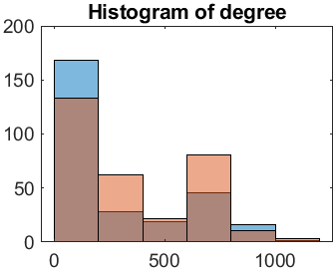
Visualizations (blue negative, pink positive)

Slide 5
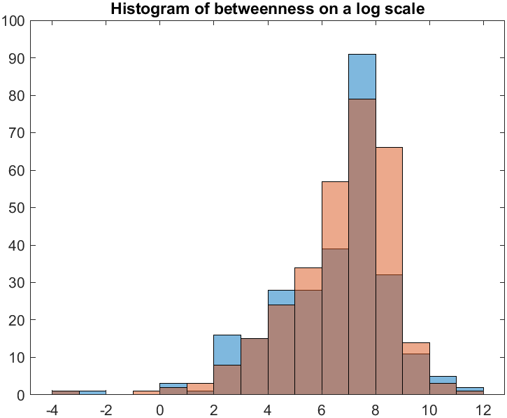
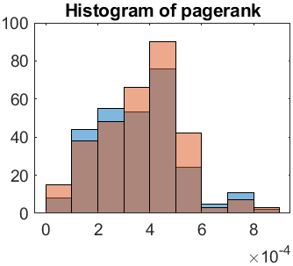
Visualizations

Slide 6
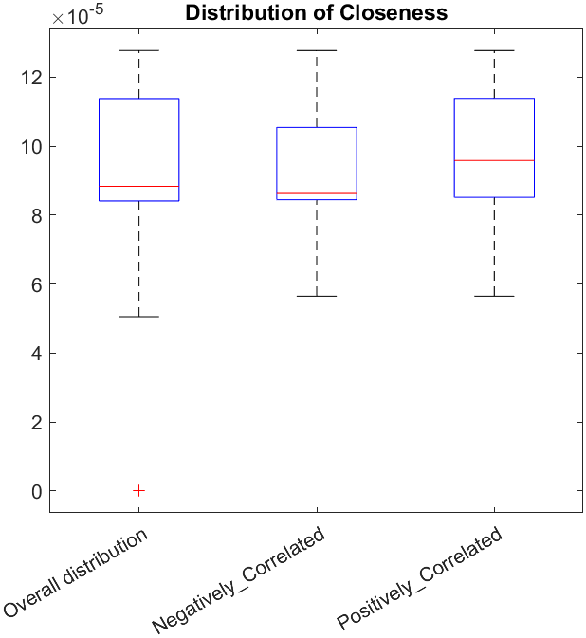
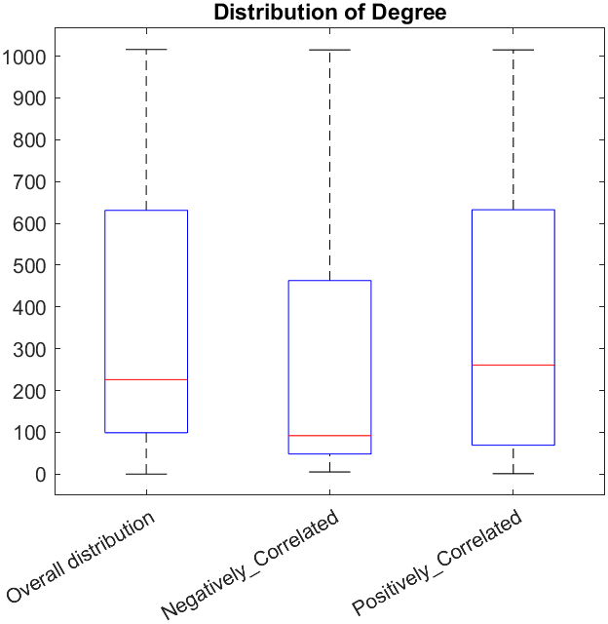
Visualizations

Slide 7
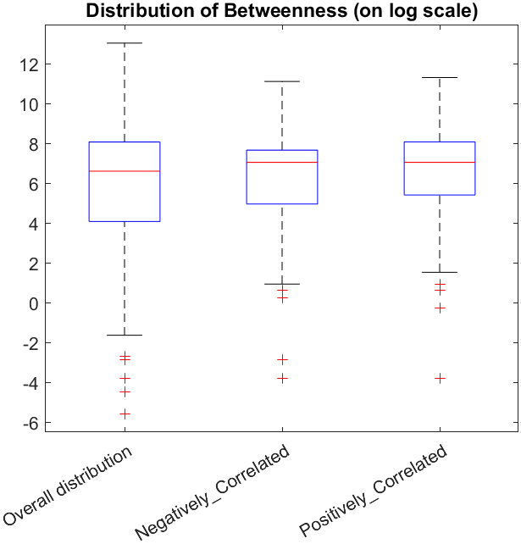
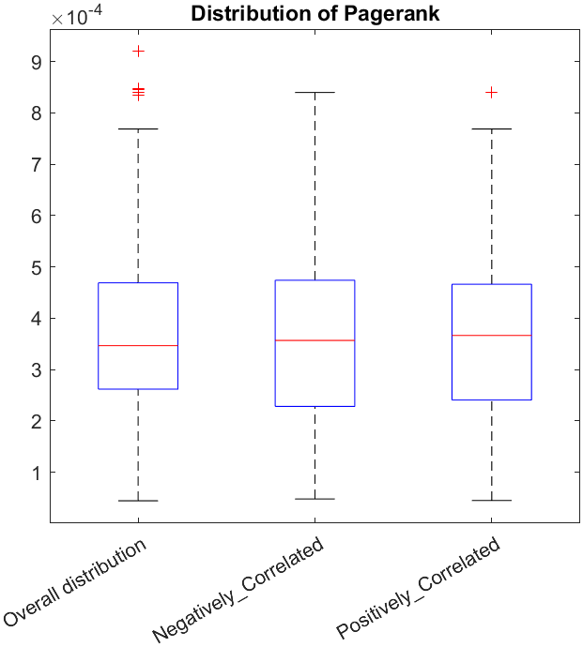
Visualizations

